Slide 1
PennyWise - Personal Budgeting and Finance Application
Iteration 2 - Team #1: Brian Fenstermacher, Jisoo Lee, Sherif Zeyada, Mali Rivera, Clyde Yeung, Chaitanya Saraogi, Sean Rawson

Slide 2
Member Roles
Team leader: Brian Fenstermacher
Requirements leader: Jisoo Lee, Chaitanya Saraogi
Design and Implementation leader: Sherif Zeyada
QA leader: Mali Rivera
Configuration leader: Clyde Yeung
Security leader: Sean Rawson

Slide 3
Iteration 2 - Key tasks
Deployment strategy
Integration with frontend and backend
Create mockup of front-end
Implement API endpoints for retrieving user data by date range
Increase test coverage for back end

Slide 4
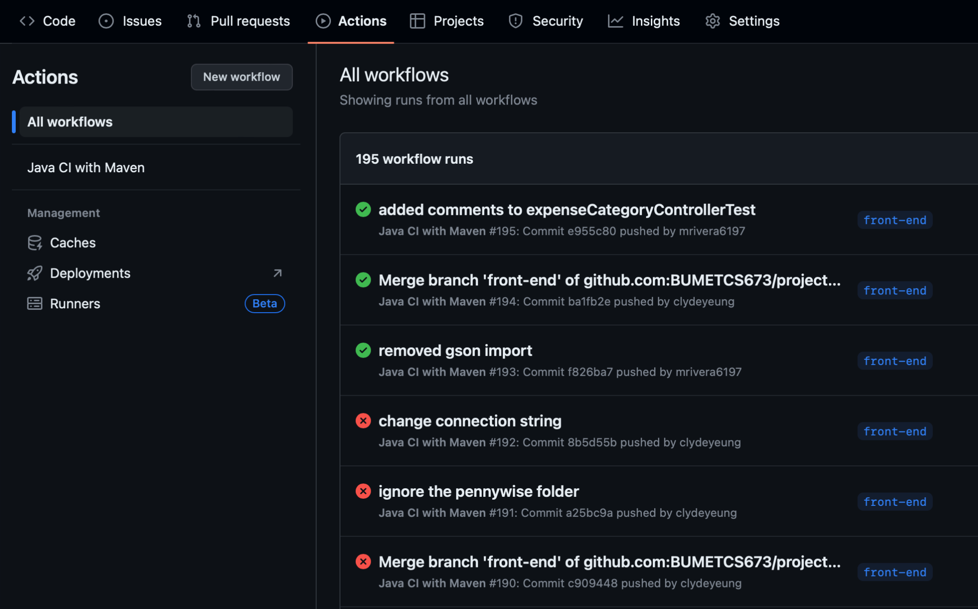
Deployment - GitHub Action
Triggered on push/PR
Multiple branches

Slide 5
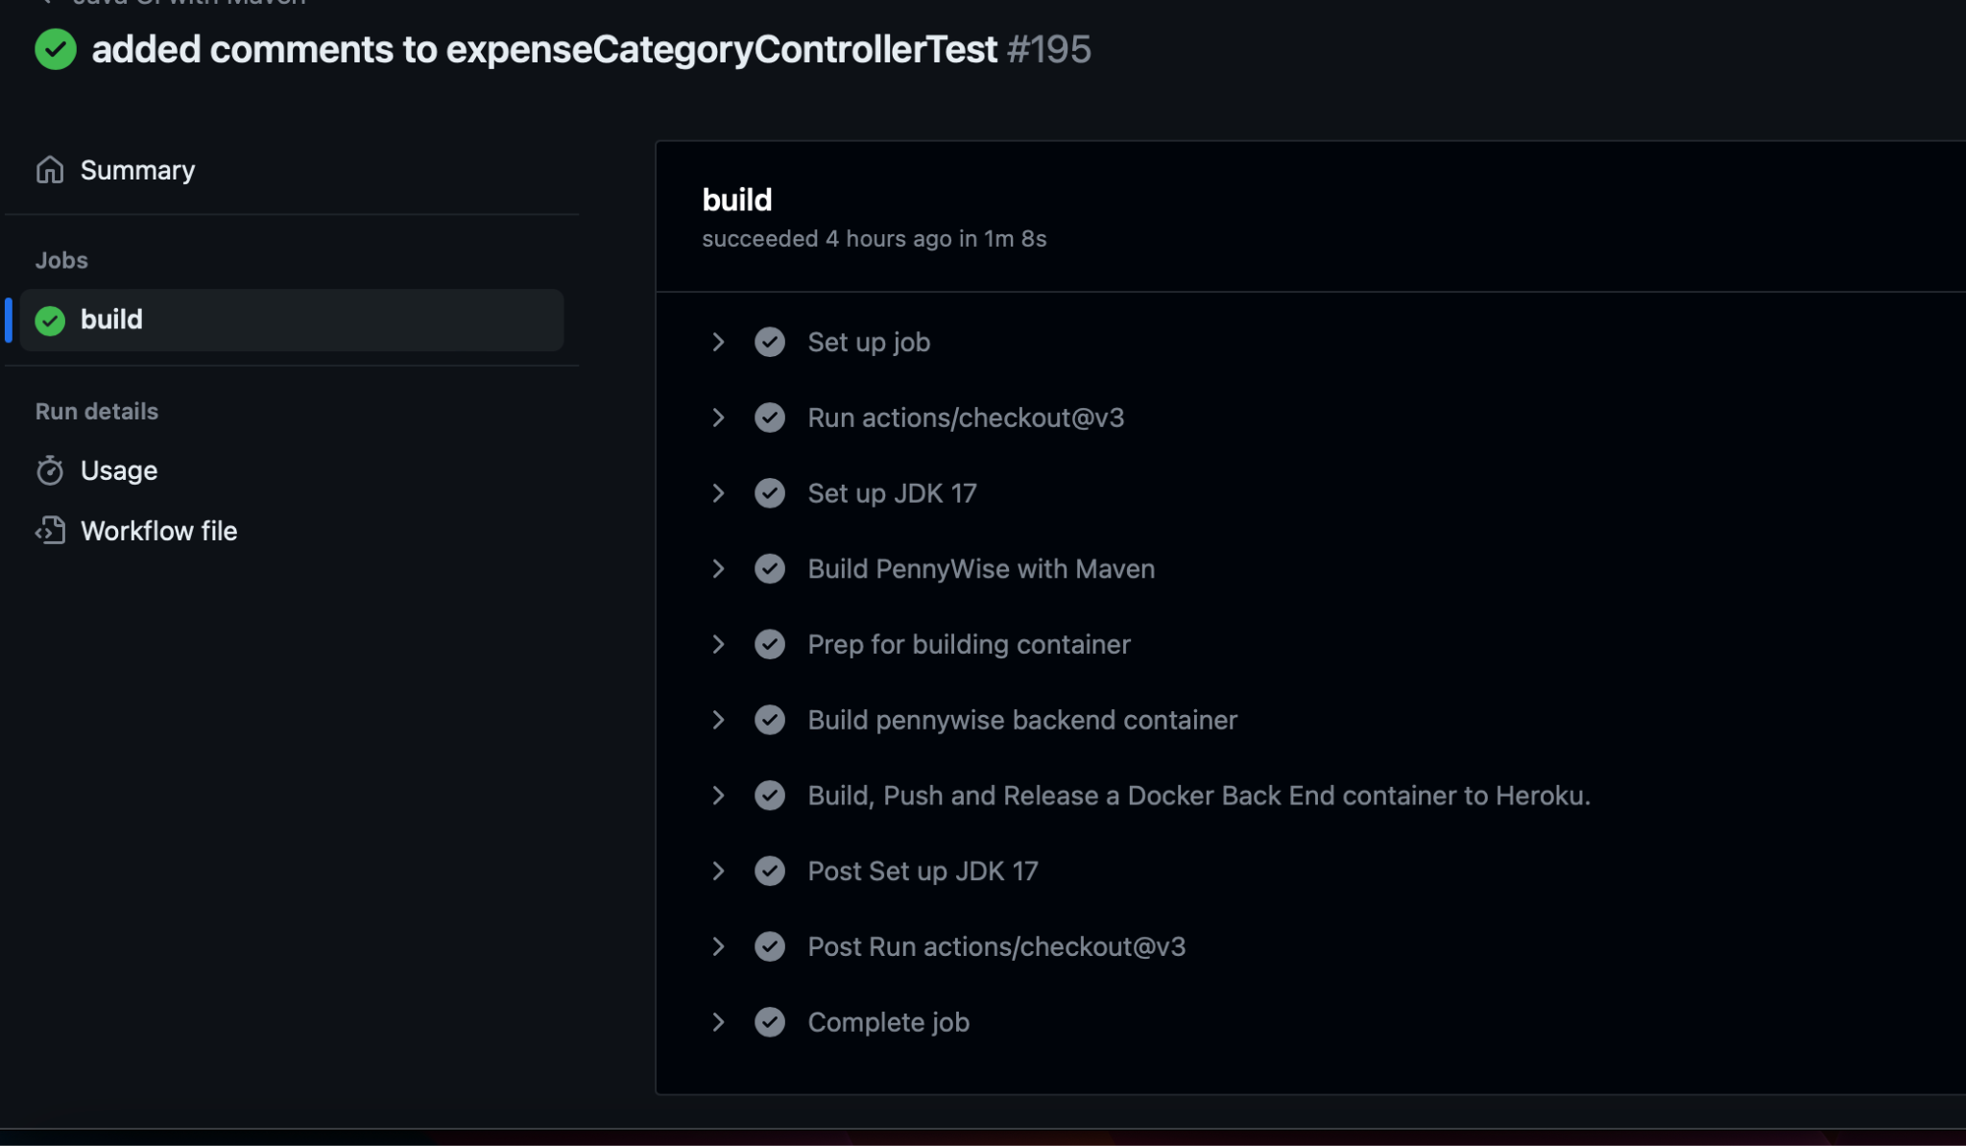
Workflow Process

Slide 6
Move to the left

Slide 7
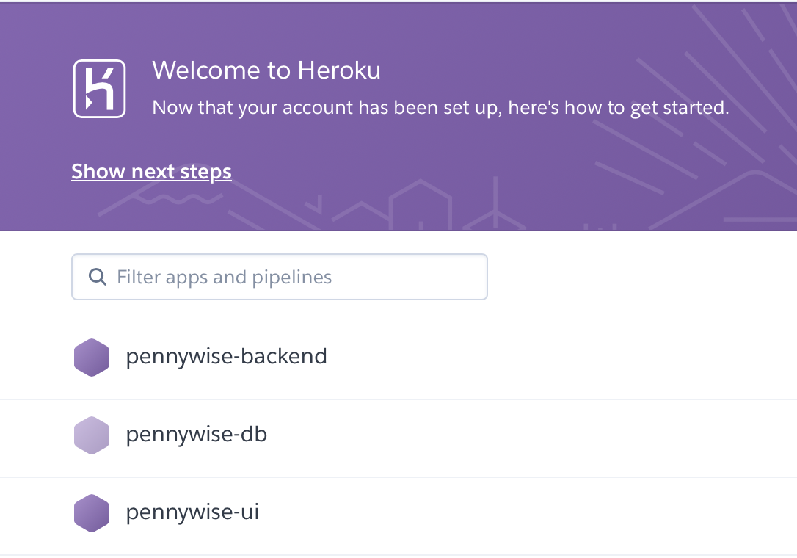
Heroku and Dynos
3 Tiers
Database
Backend
Frontend

Slide 8
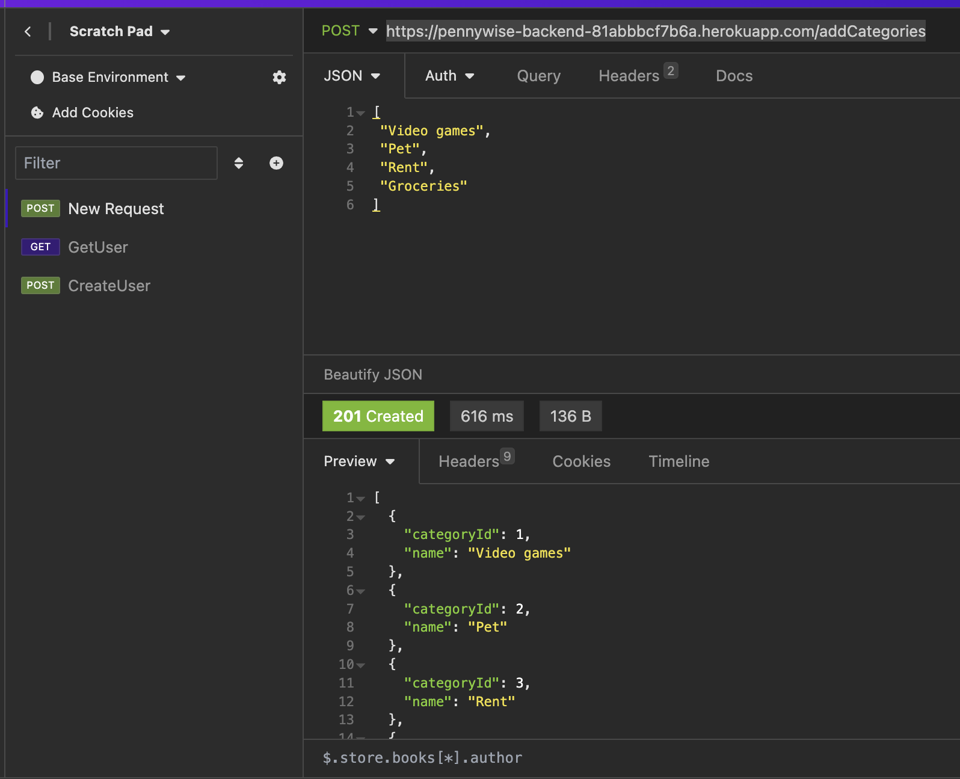
REST API in action
POST
addCategory

Slide 9
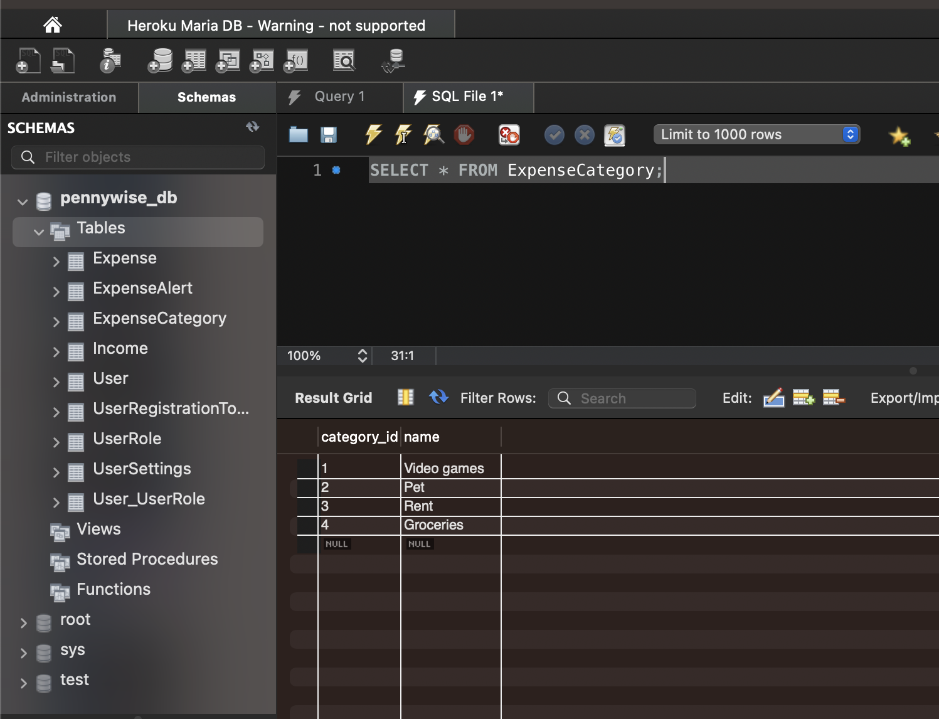
Data
External Database
Redundancy
BackUp

Slide 10
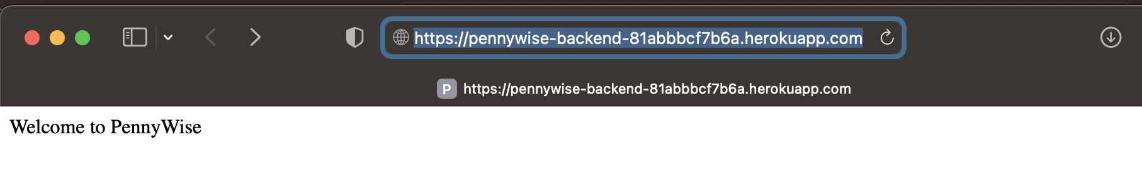
Credentials and Security
Secured HTTPS protocol

Slide 11
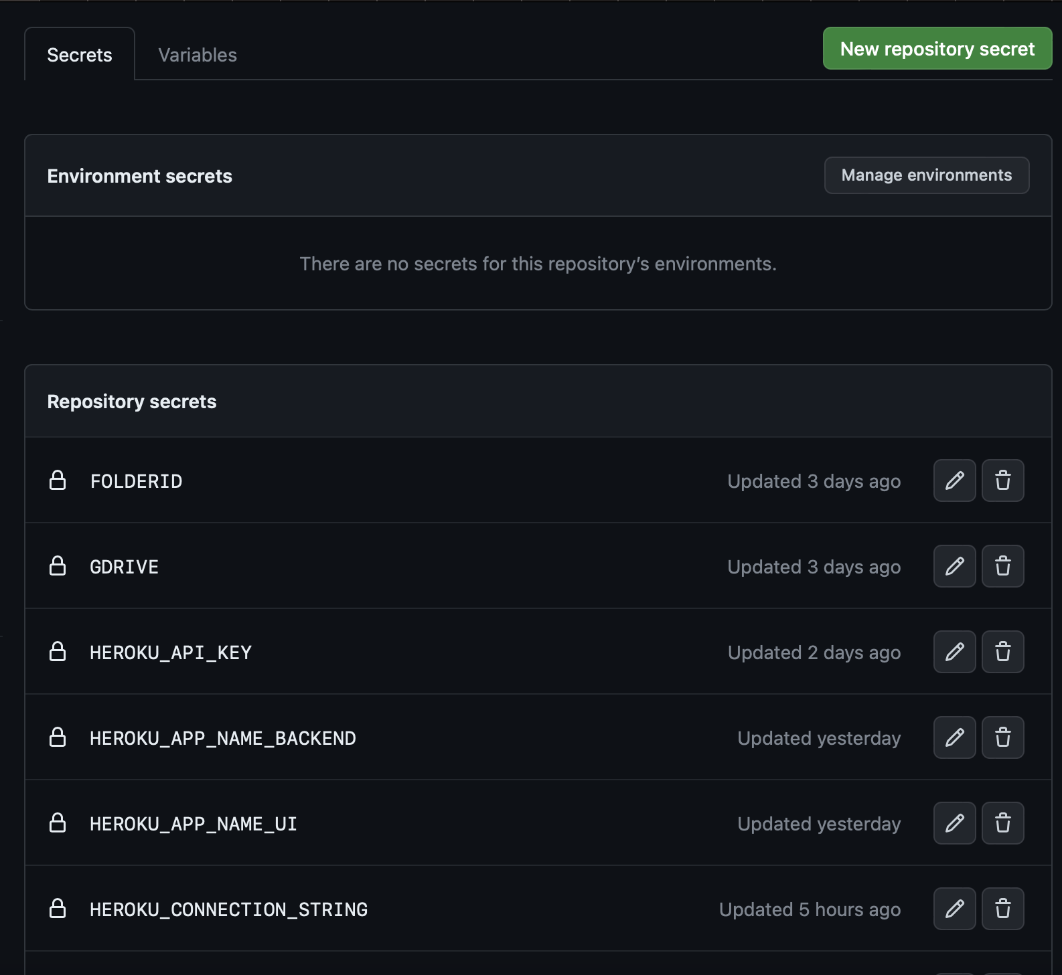
Credentials and Security
Credentials and sensitive data are store in Github secrets

Slide 12
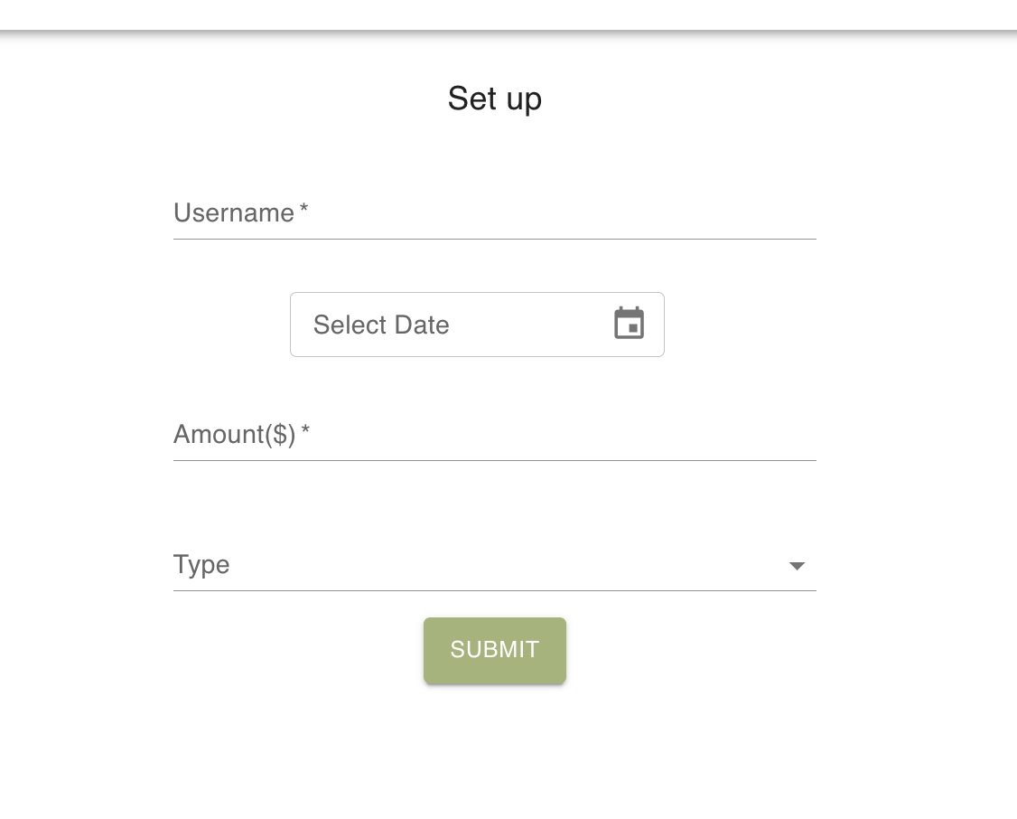
Front-end Update
Pages in Progress
SetUp Page
Dashboard Page
AddExpense Page
Login Page
Able to POST income and expense data to the DB locally
Able to GET expense data from the DB and display it for the user
Notes:
For iteration 2, we have implemented the SetUp, Dashboard and AddExpense pages. At this time, the user is able setUp their account with a user name and enter income data by date to start the budgeting application.
The user can add expense and categories to AddExpense page, and it will be updated in the dashboard page.
In the Dashboard, user can easily sort and search by the keywords. Pie chart and tables are updated real time when user updates expenses.

Slide 13
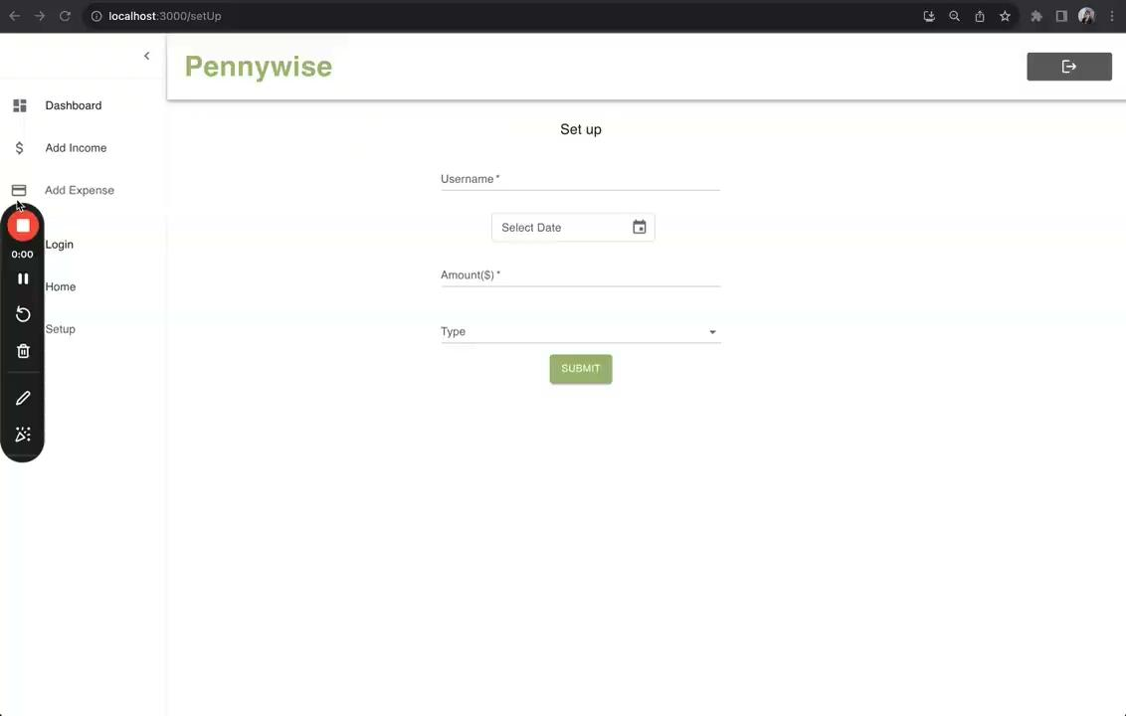
Front-End Demo
Notes:
This is the UI that we have created so far. We made an intuitive sidebar navigation for the user to navigate between the dashboard, login/signups and add expense pages.
User can easily set up the income by dates and type of income. And then the user can type in the expenses.
The dashboard presents a visual representation of the user’s expenses through a pie chart and table. The user can easily sort and search by the keywords.
The users can enter individual expenses and specify the expense category so that this information is correctly saved in the DB. The front end will access this data to continuously update the user’s expense charts.

Slide 14
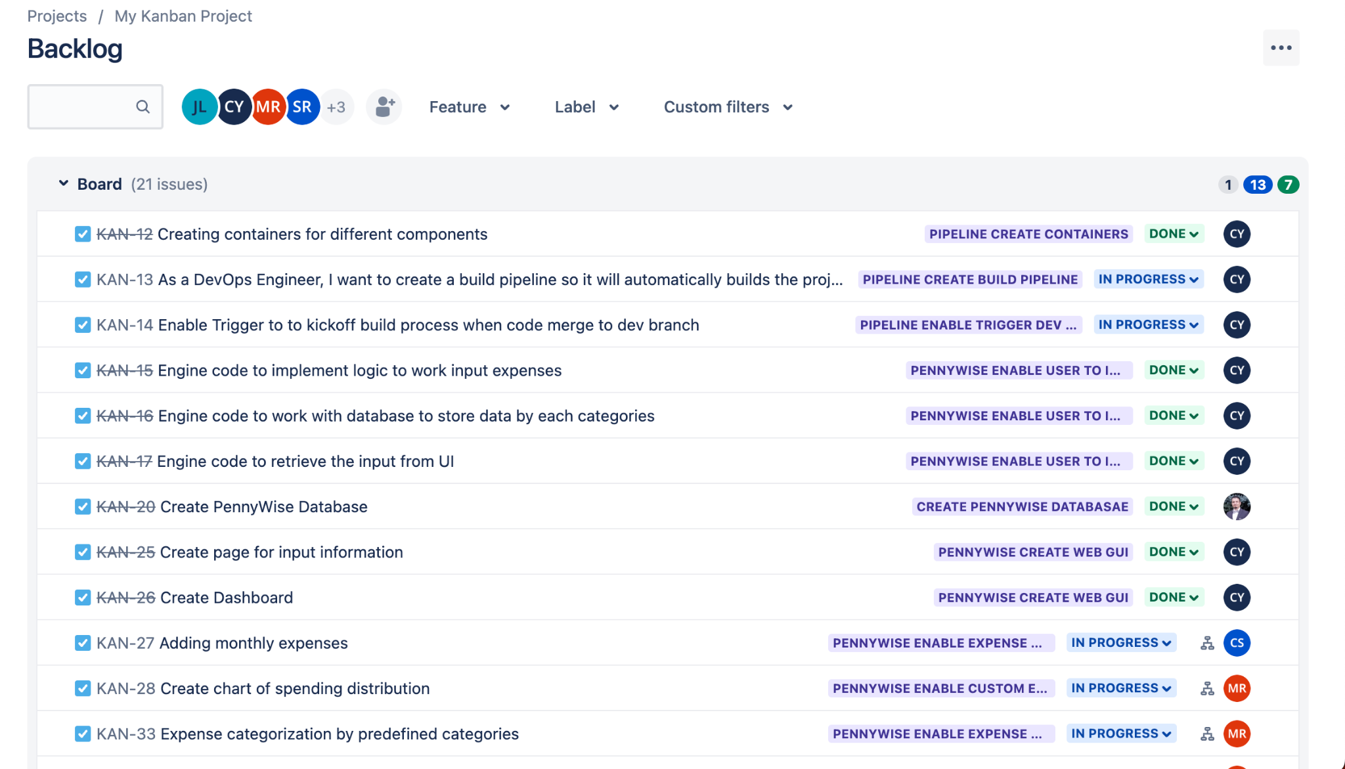
Requirements Status
13 Epics are in progress, 7 Epics are done
Notes:
Currently, our core requirements are all in progress. 13 Epics are in progress out of 21 Epics. 7 Epics are already done.

Slide 15



Testing Summary
For iteration 2, we have written Unit and Integration tests for the back end code
Unit tests were written by the developers with JUnit5 and Mockito
Integration tests were written by the QA leader with JUnit5, Mockito, and Spring Mock MVC.
Notes:
(read slide text)

Slide 16
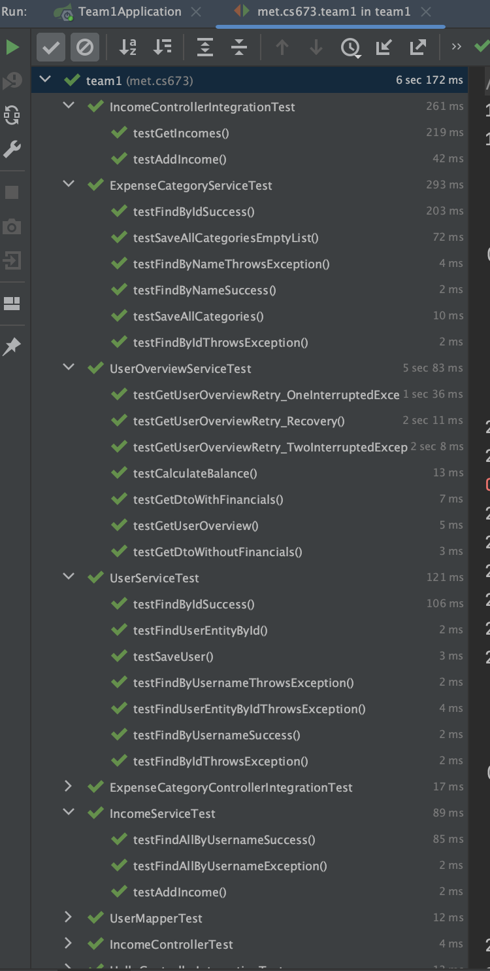
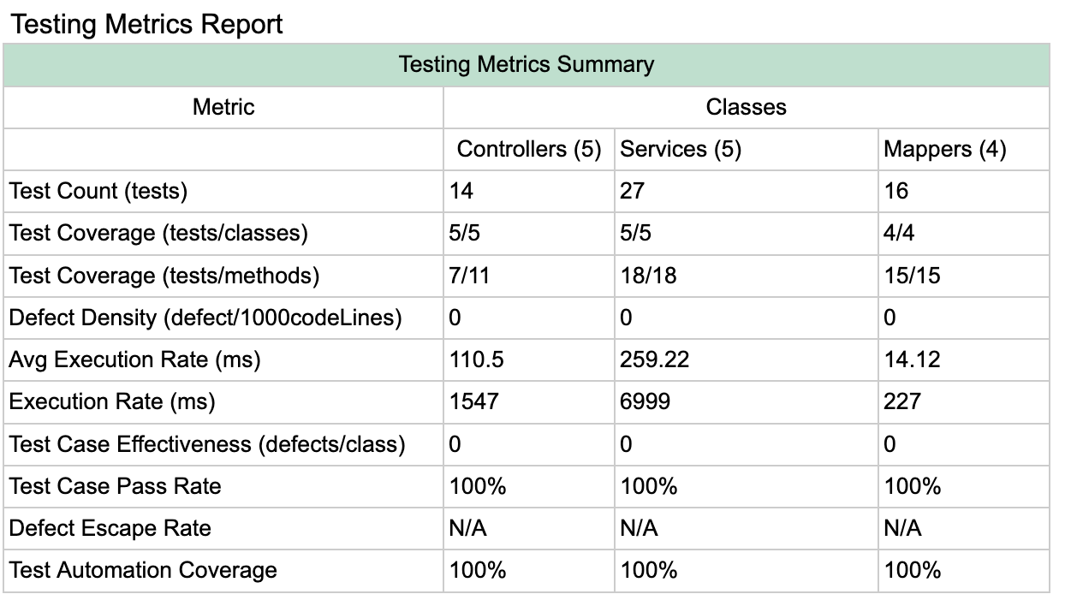
Testing Report
57/57 tests ✅
Notes:
Here’s our Testing Metrics Report. We’ve have 57/57 automated tests passing.
The metrics report breaks down the tests by class type. So here we have metrics for our different Controller, Service and Mapper classes.
We have tests covering 100% of all classes and 91% of all methods.
On the right we a screenshot of our generated Testing Report

Slide 17
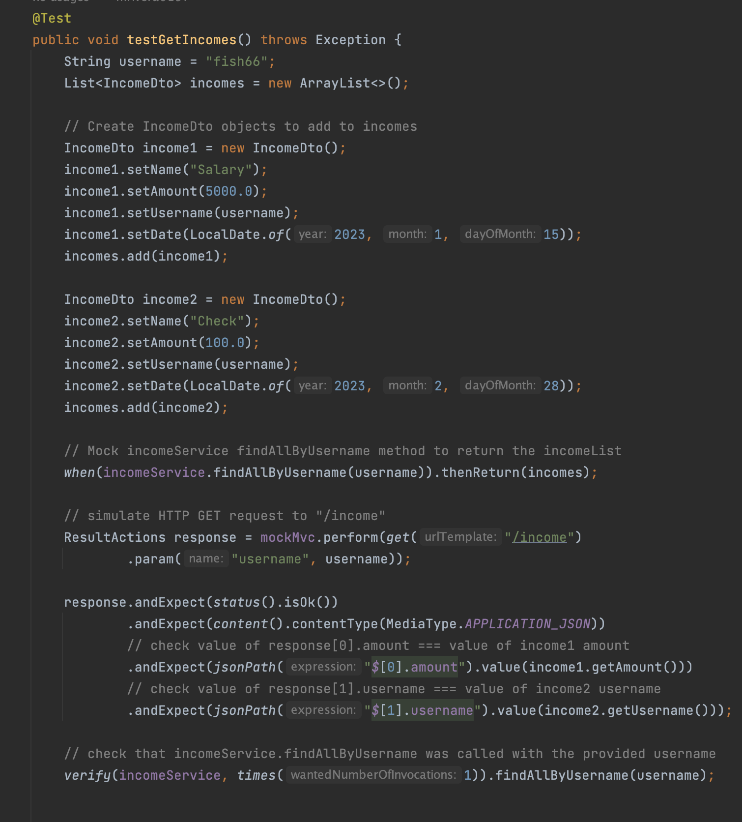
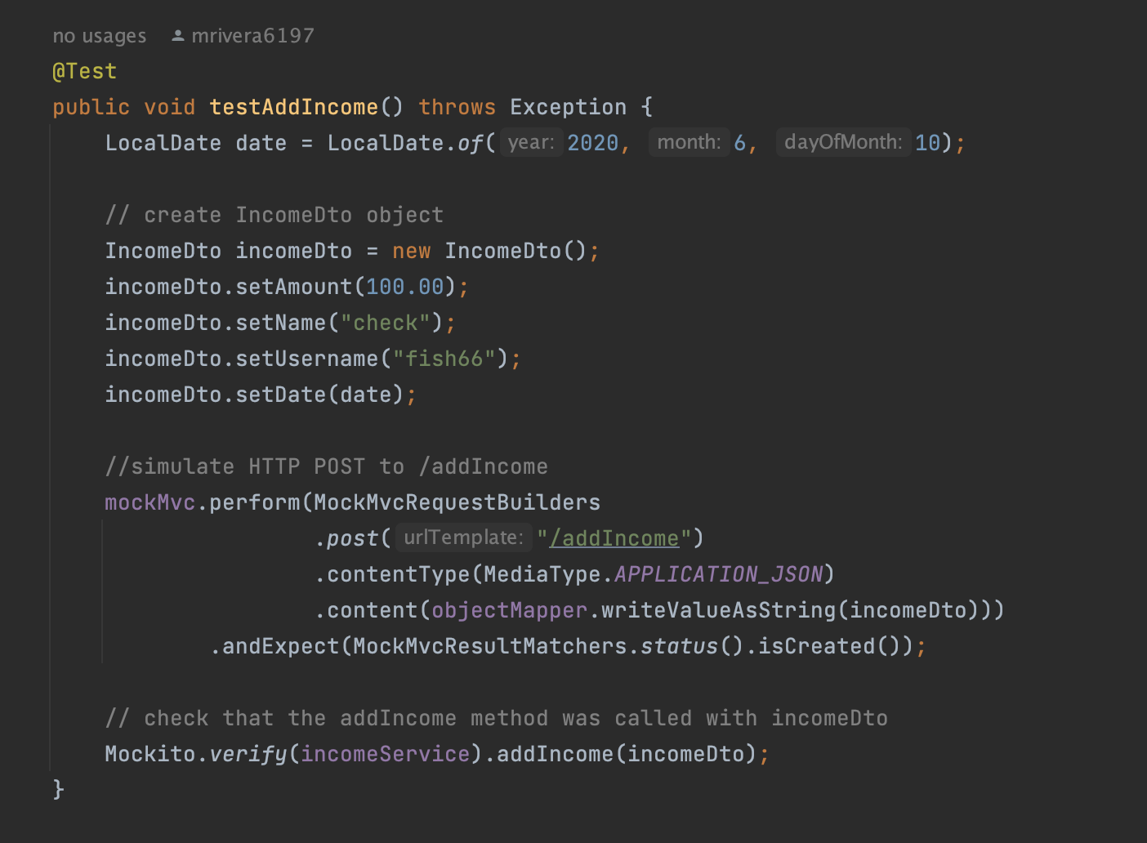
Testing Example
Notes:
Here are some examples of integration tests. These tests are for the Income Controller class.
The test on the left, tests the “/addIncome” endpoint. Here we are creating an incomeDto object and then simulating a HTTP POST request to the “/addIncome” endpoint. We are then checking that the status is 201 created.
On the right, is an example of a more complicated test. Here we are testing the “/income” endpoint. Our income endpoint returns a list of incomes. So for this test, we are first creating a list of incomeDto objects. Then mocking the findAllByUsername method of the IncomeService to return the list of incomes. Then we simulate the HTTP GET request to the “/income” endpoint and check the income amounts in the response object are equal to the input incomes.
In the next iteration, we will continue to create unit and integration tests for our code. Once the back and front end are integrated we will write acceptance tests with the Cucumber framework in JUnit .

Slide 18
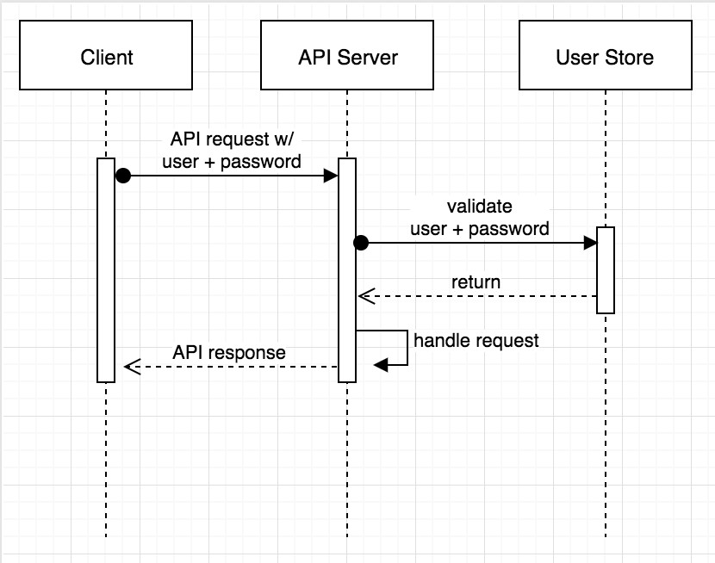
Back-End Update: Spring boot & OAuth 2.0

Slide 19

Back-End Demo

